Slide 3
英語ニュースを一次ソース でとり世界を知る
5月11日 山中泉

Slide 4
山中 泉プロフィール
一般社団法人IFA 代表理事 ファウンテン倶楽部代表
シカゴ＆東京に拠点、青森市生まれ、青森高校卒。米国在住３８年
１９８０年渡米。イリノイ大学ジャーナリズム科卒業後、 ニューヨーク野村證券で、米国株トレーダー
米国会社経営、日本メーカー北米代表
国際武道空手連合 三浦道場 師範代
２０２１年「アメリカの終わり」、２０２２年「アメリカの崩壊」が アマゾンでベストセラー１位にランクイン

Slide 5
山中泉の活動歴
キャサリン・ワイルドNY商工会議所会頭を青森、東京に招聘
石原慎太郎知事へワイルド会頭を紹介
日米ミュージシャン、経営者の文化・人材交流２５年
青森での“Japan Bluce Festival” 創業
シカゴ・オリンピック招致委員会ディレクター
日米で、製品ブランディング、販路開拓、マーケティング

Slide 6
反グローバリズムを 発信・啓蒙・教育
ファウンテン倶楽部
＆
一般社団法人
International Freedom Alliance (IFA)

Slide 7
最初の質問
英語ニュースを聞き取れる
英語での会話レベルは
伝達能力は

Slide 8
このセミナーで得ることができるもの
時事英語ニュースを聞き取るヒント
最新の米国の政治状況を知る

Slide 9
松本道弘氏 「英語の神様」

Slide 10
「giveとget」by 松本道弘
自分の原点とは？
中学2年ブルース・リーとの出会い
1980年シカゴへ一冊の本を持ち渡米
4つの段階を経て現在にいたる

Slide 11
私の英語の進化の4段階
① 道場英語
② ガールフレンドができての英語
③ 大学での英語
④ 仕事での英語

Slide 12
日本の英語教育
間違いを指摘する教育
受験のための英語
偏差値、内申書偏重の受験教育

Slide 13
ネットの情報の６割は英語
＊ネット情報の６割は英語。日本語と比べ英語で書かれた情報28倍
＊英語話者のネットユーザーは全体の２５％、日本語話者2.6%
＊単語でなく、フレーズで覚える
＊完璧を求めない
＊ 「話せる」のレベルを下げる
＊ 「大意がつかめれば良い」
＊ フィラー
Well, Ull.. You know, So, Like I mean

Slide 14
語学上達の秘訣
好きな分野から始める
イメージする 「絵にする」
翻訳しようとしない
Don’t think. Feel it !
「燃えよドラゴン」ブルース・リー

Slide 15
もしホテルで鍵を部屋に忘れた時、 フロントで何と言うか？

Slide 16
Reading, Writing, Speaking, Listening
Reading
日本人は一番早く身につく（中学英語程度である程度は読める）
AI翻訳でもある程度意味は分かる
Writing
勉強すればなんとかなるが、ニュースを英語で取る分にはとりあえず必要ない
Speaking
一番時間がかかる技能だが、ニュースを英語で取る分にはとりあえず必要ない
Listening
一番速く情報を取るために必要な技能（Breaking News）
とにかく聞いて耳を慣らす必要がある
聞き取れれば辞書でわからない単語は調べればいい
聞こえるようになると、Speakingと Writingの力も上がる
自分の耳で聞き慣れれば、話す時書く時も口に出してsounds rightだったら大体合っている

Slide 17
Listeningキーポイント
英語字幕をつけて読む
わからない単語はその場で調べる
聞こえるようになるまで何度も何度も聞く
アメリカ時事ニュースに多い表現、覚えておくと役立つ表現
裏の意味、ダブルミーニング、アメリカンジョークなど
言い換えの多用 （最初はDonald Trumpだが次に出てくる時はFormer Presidentとかとか同一人物でも表現を変わる）
よく使われる慣用句

Slide 18
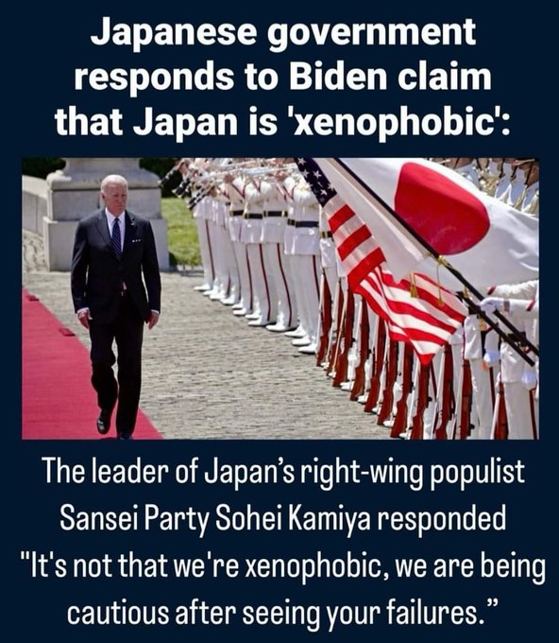
SNSで使われる英語を学ぶ
Meme （アメリカの時事問題が一番わかる、昔の風刺）
https://twitter.com/AsianDawn4/status/1787582527663993322
略語 ASAP, RSVP, ATM, BTWなど‥

Slide 19
失敗だらけのエピソード
＊ シカゴで最初に入ったバーガーキングでの体験
＊ 英会話学校で、受験校の英語教師が同じクラス
＊ 東南アジアで通じてもアメリカなど本場では 通じない
空手道場でのエピソード

Slide 20
失敗だらけのエピソード
L と R
The と a
発音が変化する 書かれた通りには発音されない
Knowの「K」やHonorの「H」、Doubtの「b」
Member of
Houston & Houston
Manhattan, hamburger, water, coke, coffee,

Slide 21
日本人に共通する問題点
TOEICは高得点（800点以上）なのに、ほとんどしゃべれない
聞いたら「こんな簡単なこと」という英語が口から出てこない
話す前に「えっと～」と頭の中で英作文をしてしまう
瞬間英作文の書籍を買ってみたけど、すぐに挫折
「英会話表現の暗記では話せるようにならない」ことに気づいた
文法の偏重
聞き取る力、会話力、コミュニケーション力の欠如

Slide 22
日常会話の会話力アップには？
簡単なフレーズの多いTV番組
Soup Opera
[例] Sex and City

Slide 23
テキサスのサラさん

Slide 24
NY郊外のマーカス青年の主張

Slide 25
保守黒人青年 マーカス
CPAC USA会場
アメリカにも多くいる保守系の黒人有権者
ブラック・ライブス・マター（BLM）は黒人コミュニティーから狙い 略奪を始めた

Slide 26
立ち上がった母親たち（ママベア）

Slide 27
母親たちは立ち上がった

Slide 28
立ち上がった母親ママベア アリーさん
Moms for America ディレクター
Patriots
Empower moms
Teaching them Life, Liberty and Happiness
Moms are heart of homes
Kitchen table to Congress
Gender ideology
We’re customers of public schools

Slide 29
質疑応答タイム 休憩

Slide 30
Part 2

Slide 31
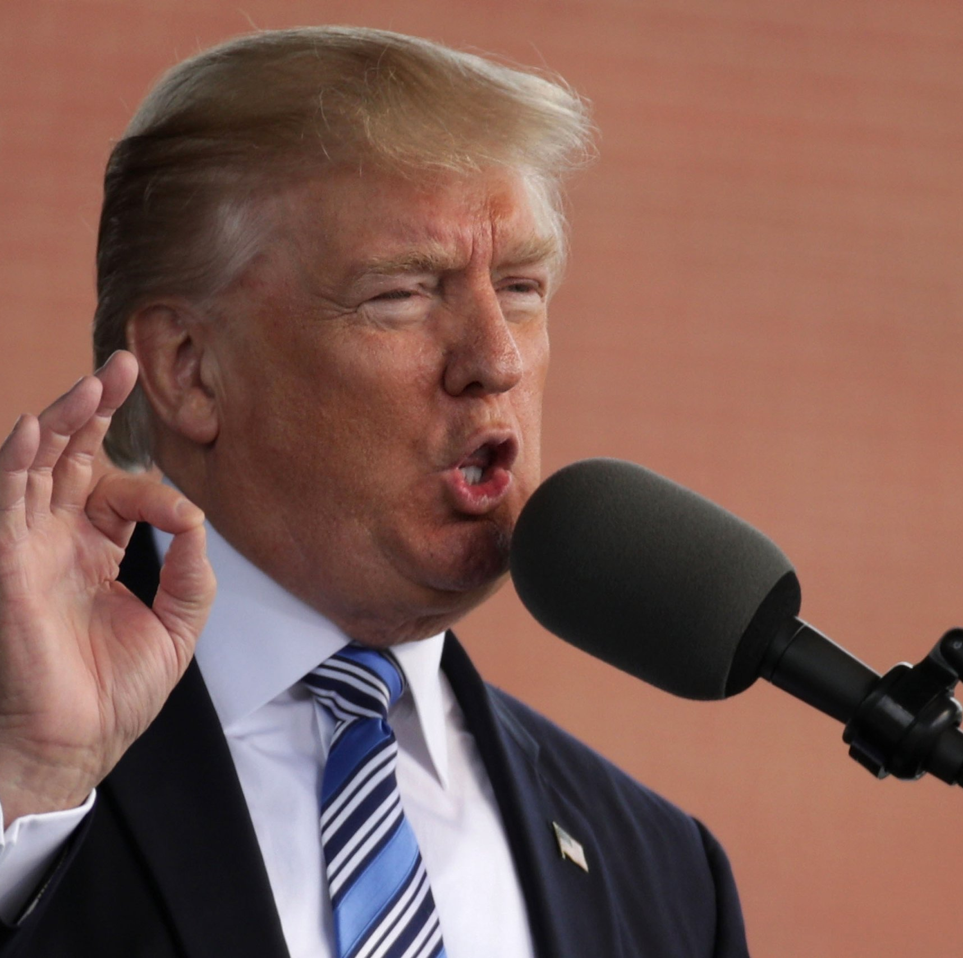
Donald
J Trump
2017年5月13日
リバティ・ユニバーシティ
大学卒業式で学生を
前にしてのスピーチ

Slide 32
トランプのリバティ大学スピーチ
Tump speech
2017
Liberty University

Slide 33
トランプ大統領スピーチ
Did we take risks? Did we dare (敢えて） to defy expectations（予想外、想定外）?
Did we challenge accepted wisdom （従来の考え方）and take on established systems(確率されたシステム）?
I think I did, but we all did and we’re all doing it.
Or did we just go along with convention(慣例に迎合）, swim downstream so easily with the current and just give in because it was the easy way, it was the traditional way or it was the accepted way?
Remember this, nothing worth doing ever, ever, ever came easy.

Slide 34
トランプ大統領スピーチ
Did we take risks? Did we dare (敢えて） to defy expectations（予想外、想定外）?
Did we challenge accepted wisdom （従来の考え方）and take on established systems(確率されたシステム）?
I think I did, but we all did and we’re all doing it.
Or did we just go along with convention(慣例に迎合）, swim downstream so easily with the current and just give in because it was the easy way, it was the traditional way or it was the accepted way?
Remember this, nothing worth doing ever, ever, ever came easy.

Slide 35
Following your convictions means you must be willing to face criticism（批判を直面し） from those who lack the same courage to do what is right. And they know what is right, but they don’t have the courage or the guts or the stamina（彼らは勇気を持つガッツもスタミナもない人たちだ）
I know that each of you will be a warrior for the truth, will be a warrior for our country
and for your family. I know that each of you will do what is right, not what is the easy way, and that you will
In my short time in Washington I’ve seen firsthand how the system is broken（システムは壊れていた）.
A small group of failed voices who think they know everything and understand everyone want
to tell everybody else how to live and what to do and how to think.
But you aren’t going to let other people tell you what you believe,

Slide 36
Following your convictions means you must be willing to face criticism（批判を直面し） from those who lack the same courage to do what is right. And they know what is right, but they don’t have the courage or the guts or the stamina（彼らは勇気を持つガッツもスタミナもない人たちだ）
I know that each of you will be a warrior for the truth, will be a warrior for our country
and for your family. I know that each of you will do what is right, not what is the easy way, and that you will
In my short time in Washington I’ve seen firsthand how the system is broken（システムは壊れていた）.
A small group of failed voices who think they know everything and understand everyone want
to tell everybody else how to live and what to do and how to think.
But you aren’t going to let other people tell you what you believe,

Slide 37
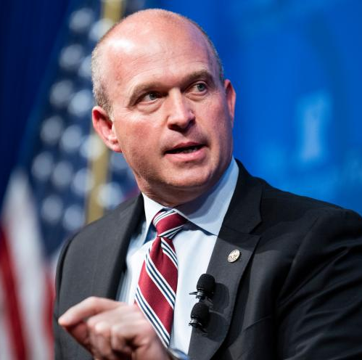
Kevin
Roberts
ヘリテイジ財団代表 ケヴィン・ロバーツ博士

Slide 38
ダボス会議での波乱
ヘリテージ財団代表
president of heritage Dr. Kevin Roberts
保守系シンクタンク
時期トランプ政権の ”政権以降チーム”の戦略と 政策立案を担当

Slide 39
ダボス会議？ “お笑い種だ”
It’s laughable that Davos is protecting “Liberal Democracy”.
Elites tell us ”Open border” and “Illegal Immigration” is ok.
The Average person in US tells us both rob them of American way of Life.
Elites also tells Public Safety isn’t problem in American big cities, just travel New York or Washington or Dallas Texas the average person will tell you that the lack of Public Safety damages not just the American way of life but their life.

Slide 40
ダボス会議？ “お笑い種だ”
It’s laughable that Davos is protecting “Liberal Democracy”.
Elites tell us ”Open border” and “Illegal Immigration” is ok.
The Average person in US tells us both rob them of American way of Life.
Elites also tells Public Safety isn’t problem in big American cities, just travel New York or Washington or Dallas Texas the average person will tell you that the lack of Public Safety damages not just the American way of life but their life.

Slide 41
気候変動と中国
Elites tell us that we we have this existential crisis with so-called climate change
the solutions the average person know cost more human lives especially in Europe during the time that you need heating than do the problem and the problems themselves the
China the number one adversary not just to the United States but to Free People on planet Earth not only do we at at Davos not say that we give the Chinese Communist Party a platform

Slide 42
気候変動と中国
Elites tell us that we we have this existential crisis with so-called climate change
the solutions the average person know cost more human lives especially in Europe during the time that you need heating than do the problem and the problems themselves the
China the number one adversary not just to the United States but to Free People on planet Earth not only do we at at Davos not say that we give the Chinese Communist Party a platform

Slide 43
”超”国家機関 WHO (世界保健機関)
World Health Organization is discussing
foisting gender ideology upon the Global South these are practices that are under review if not being rejected by countries in northern Europe
the new President the special of its President Trump will as you like to say
trust the science he will understand the basic biological reality of manhood and womanhood and do you know why not because of Retribution not because he’s a dictator but because he has the power of the American people behind him.

Slide 44
”超”国家機関 WHO (世界保健機関)
World Health Organization is discussing
foisting gender ideology upon the Global South these are practices that are under review if not being rejected by countries in northern Europe
the new President the special of its President Trump will as you like to say
trust the science he will understand the basic biological reality of manhood and womanhood and do you know why not because of Retribution not because he’s a dictator but because he has the power of the American people behind him.

Slide 45
ウクライナへの支援
let ms just correct the uh the slight assertion you made there we want Ukraine to win we want to see Ukraine win with a lot more help from European allies.
I think the United States has a role Heritage has been clear about this for 2 years now that there is a world in which we support military aid for Ukraine
our first obligation in foreign policy is to look at it through the lens of what’s best for the American citizen
Joe Biden has done a god- awful job in articulating what that is the kind of

Slide 46
ウクライナへの支援
let ms just correct the uh the slight assertion you made there we want Ukraine to win we want to see Ukraine win with a lot more help from European allies.
I think the United States has a role Heritage has been clear about this for 2 years now that there is a world in which we support military aid for Ukraine
our first obligation in foreign policy is to look at it through the lens of what’s best for the American citizen
Joe Biden has done a god- awful job in articulating what that is the kind of

Slide 47
世界経済フォーラム(WEF)の すべてのアジェンダを破壊する
person who will come into the next conservative Administration is going to be governed by one principle and that is destroying the grasp that political Elites and unelected technocrats have over the average person
and I will be candid and say that the agenda that every single member of the administration needs to have is to compile a list of everything that's ever been proposed at the World Economic Forum and object all of them wholesale

Slide 48
世界経済フォーラム(WEF)の すべてのアジェンダを破壊する
person who will come into the next conservative Administration is going to be governed by one principle and that is destroying the grasp that political Elites and unelected technocrats have over the average person
and I will be candid and say that the agenda that every single member of the administration needs to have is to compile a list of everything that's ever been proposed at the World Economic Forum and object all of them wholesale

Slide 49
I worry every day about the financial future （将来の収入と暮らし）for my children
I worry about the debt they're inheriting（借金のツケ）
I worry about if they're going to be able to buy a new car or buy a new house if they're going to be able to pay off their credit card bills （カード支払い）and still put food on their table
we know that Joe Biden has taken our energy Independence and he's put crippling regulation and mandates on our businesses （他国にエネルギーを依存させた政策）
we‘re in an economic crisis right now that has taken the American dream away（アメリカンドリームを奪った） from so many families including my own children

Slide 50
I know that other moms like me and dads and families also care about their financial future for their children （子供の将来の家計や暮らし）
I worry about my kids safety every day （安全性）
I worry about my kids when they're not with me
I worry about them when they're driving
I worry about them when they're out with their friends or when they're at college and when they're alone
Joe Biden has made our communities less safe he's done there through a wide open border（国境の壁オープン） that I visited twice we've got to put some

Slide 51
I know that other moms like me and dads and families also care about their financial future for their children （子供の将来の家計や暮らし）
I worry about my kids safety every day （安全性）
I worry about my kids when they're not with me
I worry about them when they're driving
I worry about them when they're out with their friends or when they're at college and when they're alone
Joe Biden has made our communities less safe he's done there through a wide open border（国境の壁オープン） that I visited twice we've got to put some

Slide 52
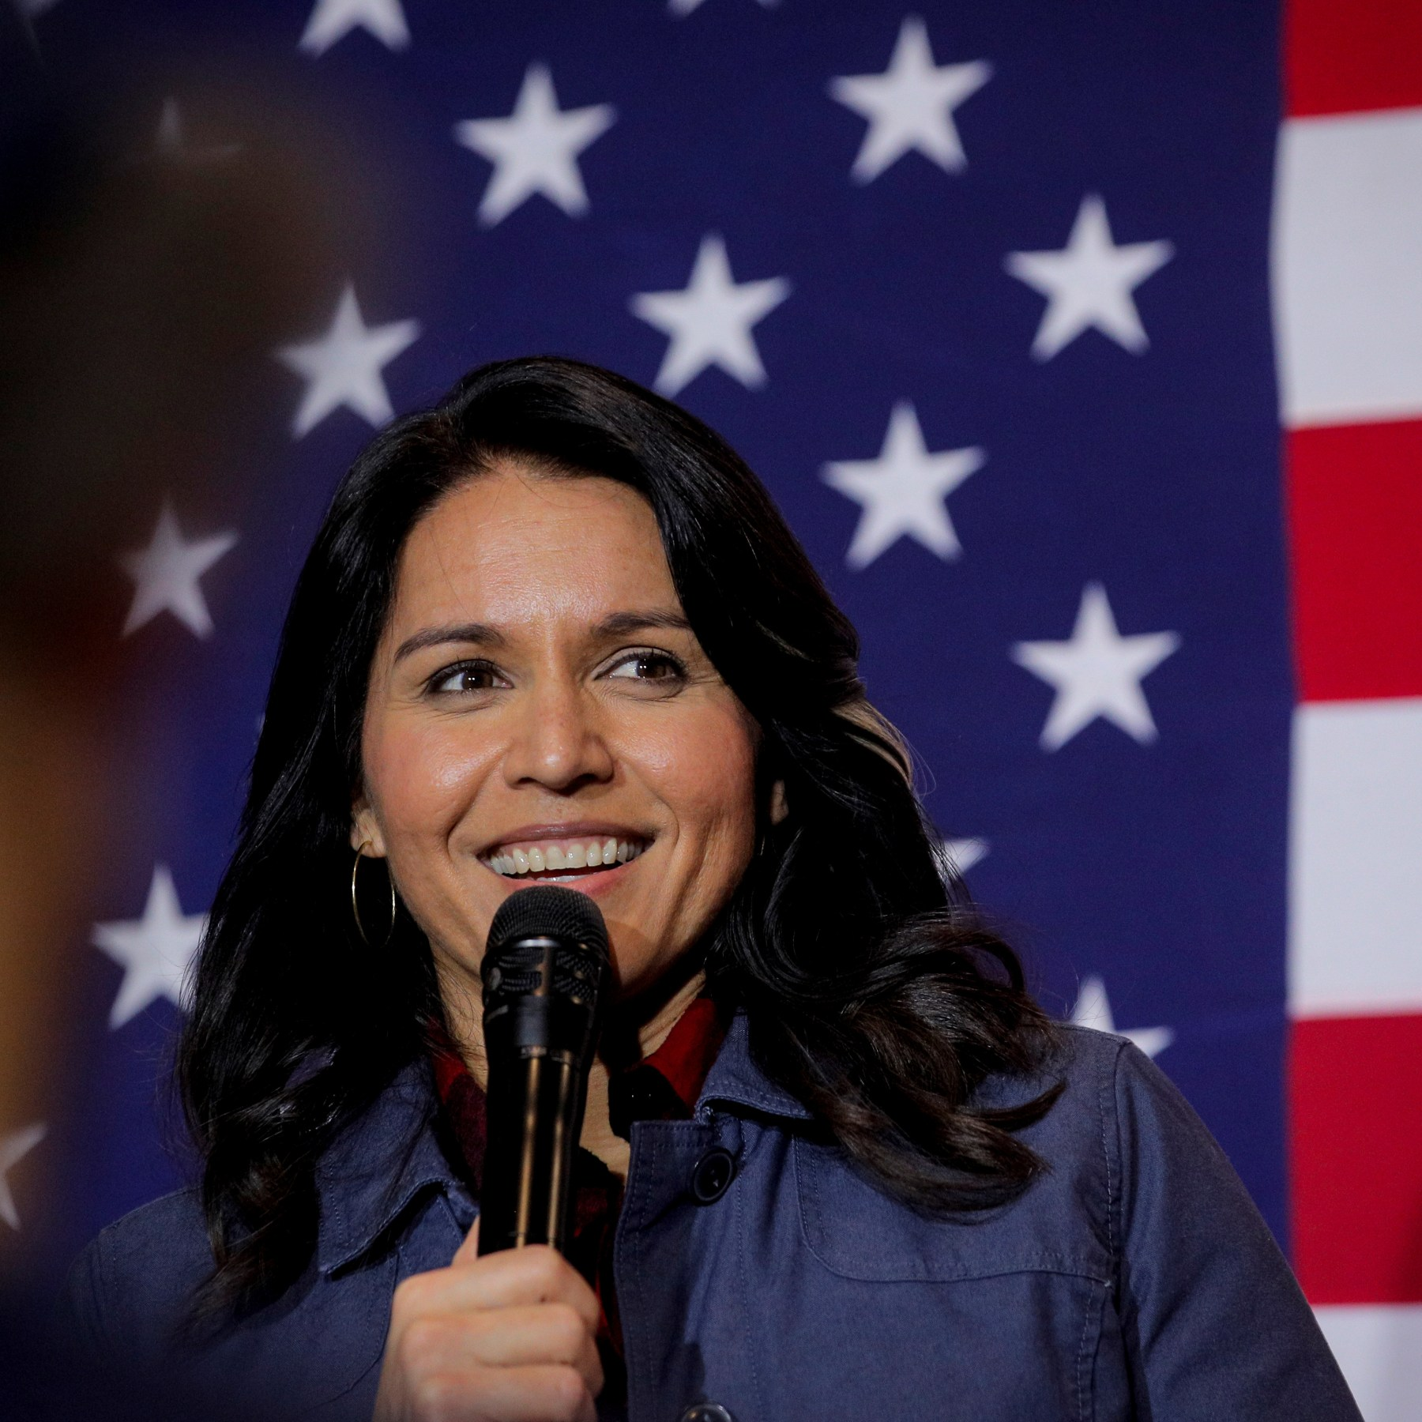
Tulsi
Gabbard
トゥルシー・ガバード
元議員

Slide 53
トゥルシー・ガバード元議員
Tulsi Gabbard Explains Who Actually Runs The Government

Slide 54
watching has which is who is running the government at this point is obviously not Joe Biden you think Hillary I there
it's not a a leap of of imagination to know that that's true when you look at the people who are in Joe Biden’s Administration they are the the the people who the right hands for the Obama Administration for President Obama and for for Hillary Clinton
uh when Hillary Clinton said herself the other day she said oh yeah I talk to the White House every day
so it's not there's no shock or surprise uh who the influences are behind the policies that are coming out of this white house that many people sayis the most radical and woke White House that our country has ever seen

Slide 55
watching has which is who is running the government at this point is obviously not Joe Biden you think Hillary I there
it's not a a leap of of imagination to know that that's true when you look at the people who are in Joe Biden’s Administration they are the the the people who the right hands for the Obama Administration for President Obama and for for Hillary Clinton
uh when Hillary Clinton said herself the other day she said oh yeah I talk to the White House every day
so it's not there's no shock or surprise uh who the influences are behind the policies that are coming out of this white house that many people sayis the most radical and woke White House that our country has ever seen

Slide 56
oh well there's there's no question about it so but as this was happening to you I mean I'm sure you didn't want to go to the White House correspondence din are good for you tiresome but on the other hand it is a lot easier and much more pleasant to be loved than it is to be hated
I think it's just true and so as you became like really hated by the leadership of the democratic party and they weren't hiding it at all no did you ever think like maybe it's just easier to kind of pretend bombing is a good idea did you ever question your decision to say no no I I knew what that that would be true I knew that there was certainly an easier

Slide 57
oh well there's there's no question about it so but as this was happening to you I mean I'm sure you didn't want to go to the White House correspondence din are good for you tiresome but on the other hand it is a lot easier and much more pleasant to be loved than it is to be hated
I think it's just true and so as you became like really hated by the leadership of the democratic party and they weren't hiding it at all no did you ever think like maybe it's just easier to kind of pretend bombing is a good idea did you ever question your decision to say no no I I knew what that that would be true I knew that there was certainly an easier

Slide 58
質疑応答タイム 休憩

Slide 59
Part 3

Slide 60
否定的言葉を肯定的言葉に 変えていく 言葉の魔法

Slide 61
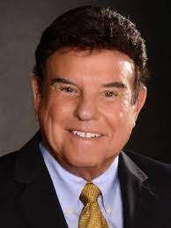
Tom Hopkins
米国の伝説のトップ
セールストレーナー
３年連続カルフォルニア州の住宅販売No.１
５００万人のセールス・プロフェッショナルをトレーニング
ベストセラー著書“How to sell”はミリオンセラー
35,000社を指導

Slide 62
成功する米国人リーダーが
使わない言葉１
Problem
challenge
Price
total investment
Contract
paperwork, agreement
Sign
endorse, approve, authorize

Slide 63
成功する米国人リーダーが
使わない言葉２
Mortgage
monthly investment
Down payment
initial investment
Buy
own
Sell or sold
get them involved, help them acquired
Objection
area of concern

Slide 64
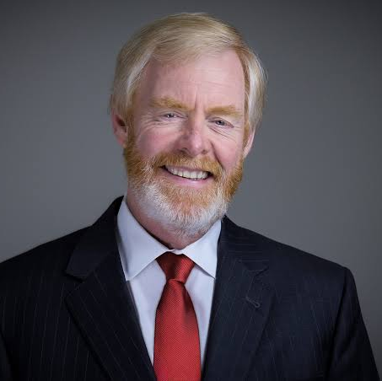
Media Research Center
Brent
Bozell
米メディア 研究所の大物

Slide 65
選挙を盗んだのは”メディア”だ

Slide 66
LGBTQクレージーの
現場の小学生の発言
6th Grader Testifies About Her Experience With A Boy Who Changed In Front of Her In The Locker Room Lebanon Community School Corporation, Indiana

Slide 67
LGBTQクレージーの
現場の小学生の発言
6th Grader Testifies About Her Experience With A Boy Who Changed In Front of Her In The Locker Room Lebanon Community School Corporation, Indiana

Slide 68
ファウンテン倶楽部とIFA会員
情報収集
＊シルバー
教育
＊ゴールド
発信
＊プラチナ

Slide 69
ファウンテン倶楽部 ＆ IFA会員特典

Slide 70
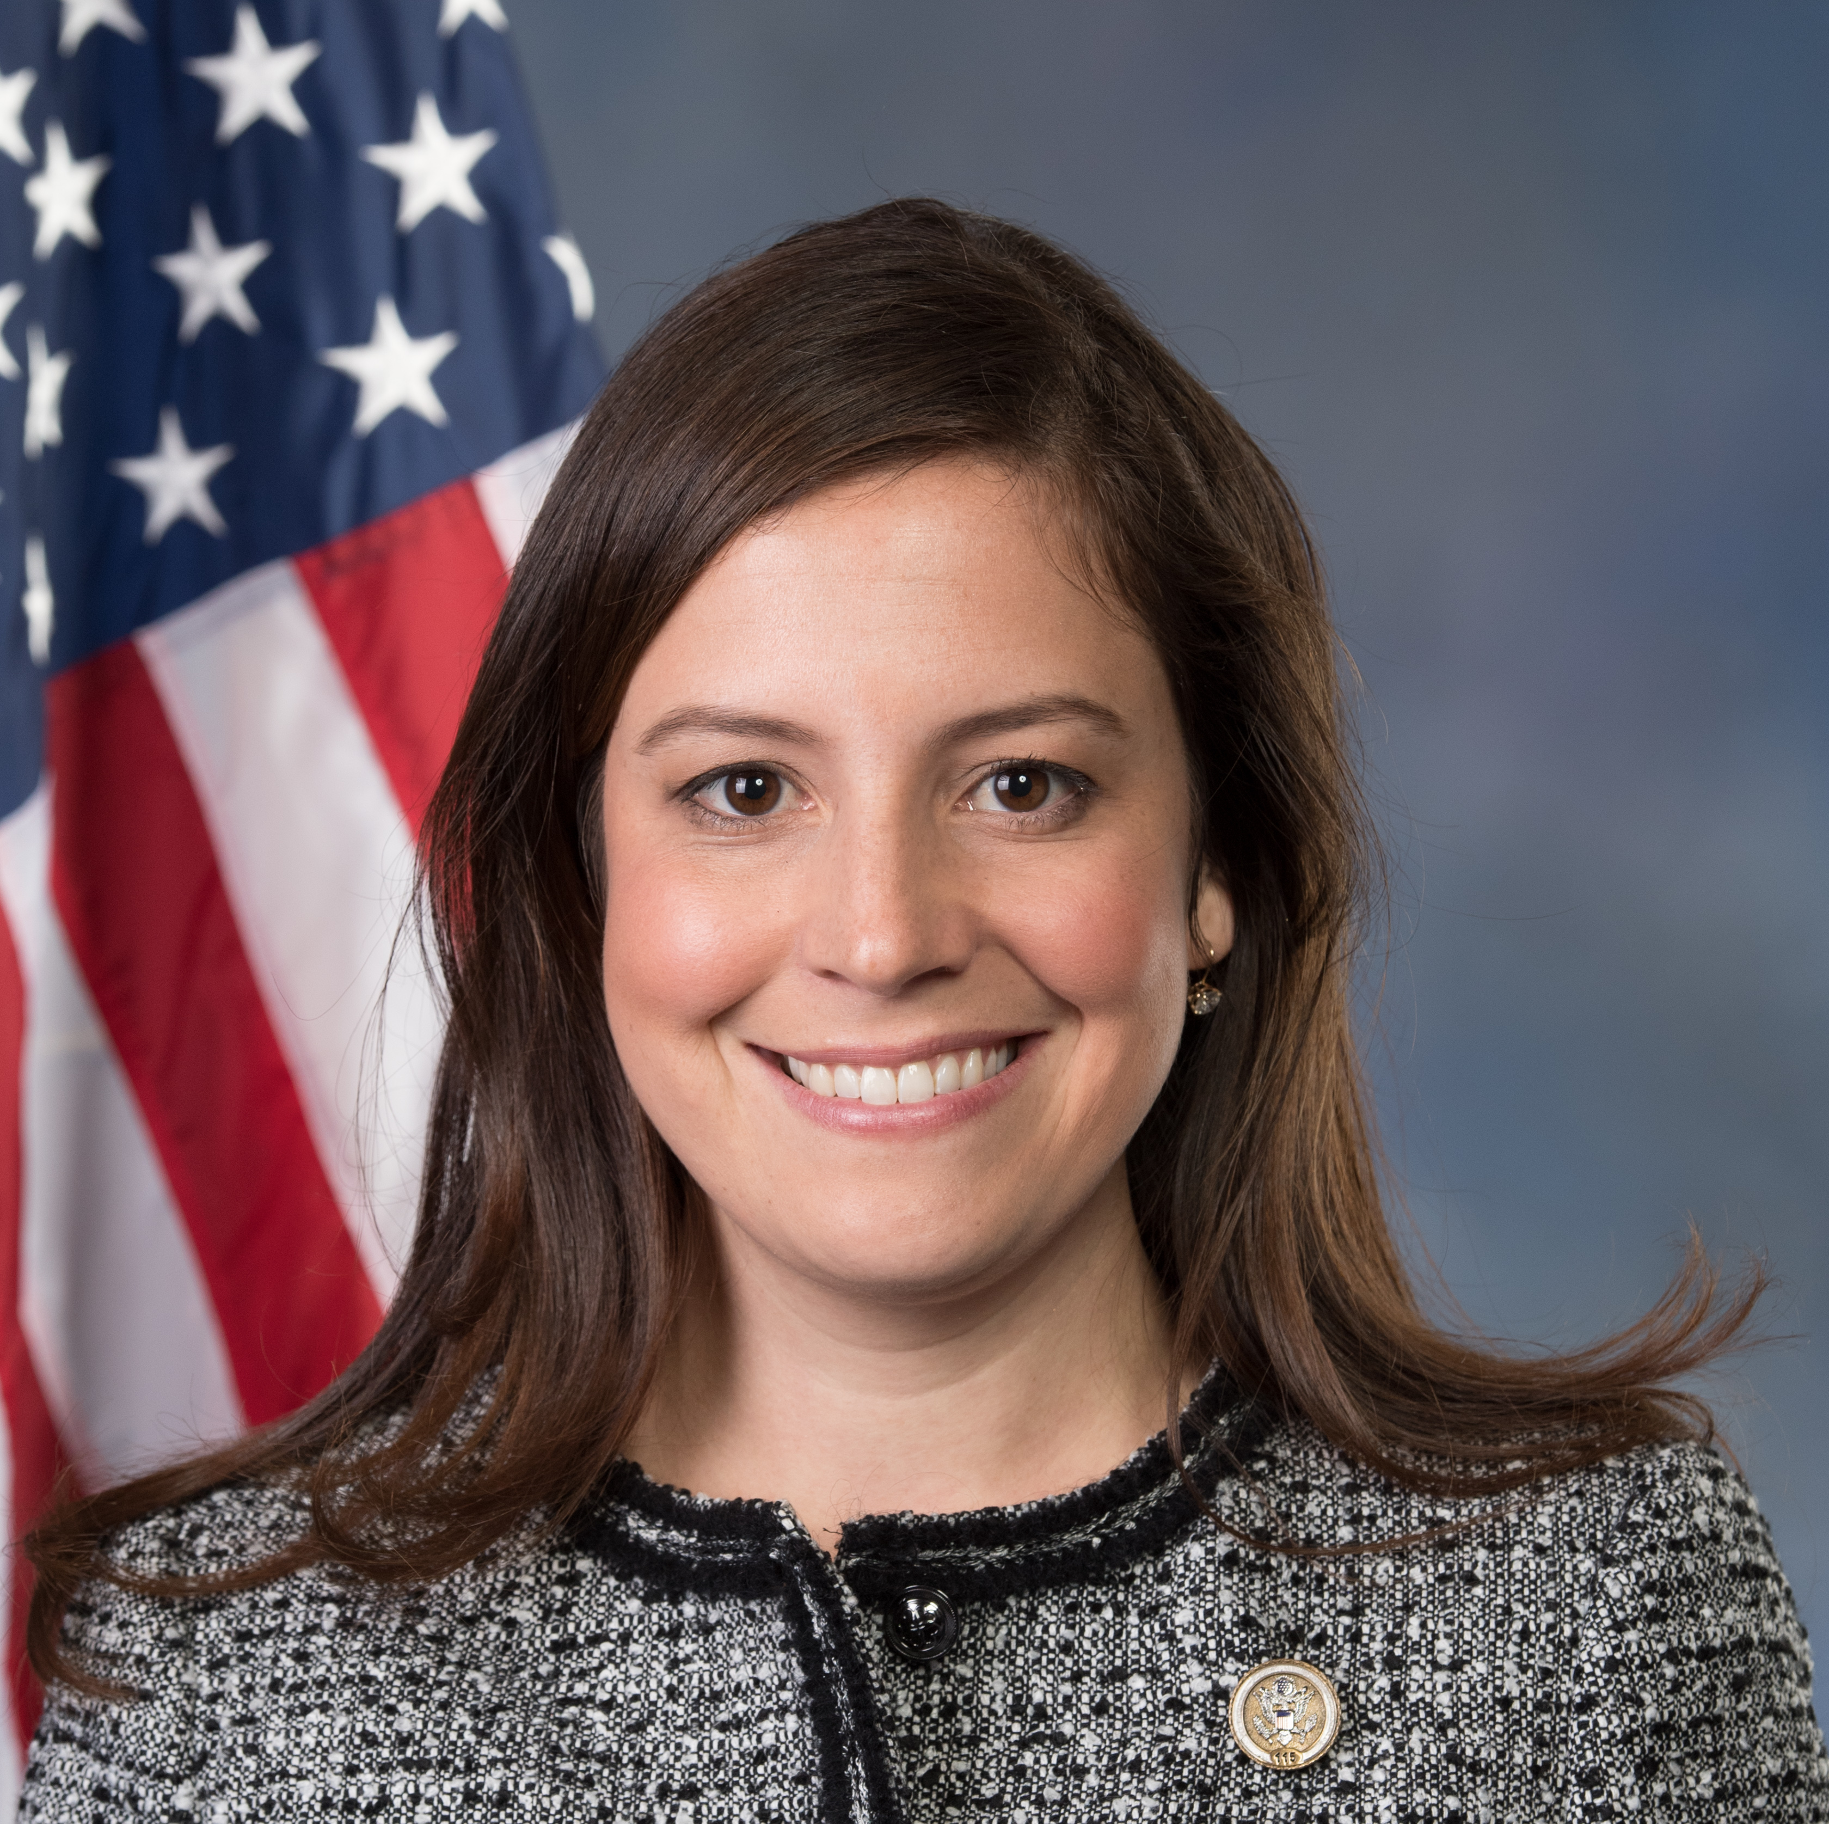
Elise
Stefanik
エリス・ステファニック
下院議員

Slide 71
共和党No.3の女性議員 エリス・ステファニック
3-11 after Biden State of Union Speech
（バイデン一般教書演説後）

Slide 72
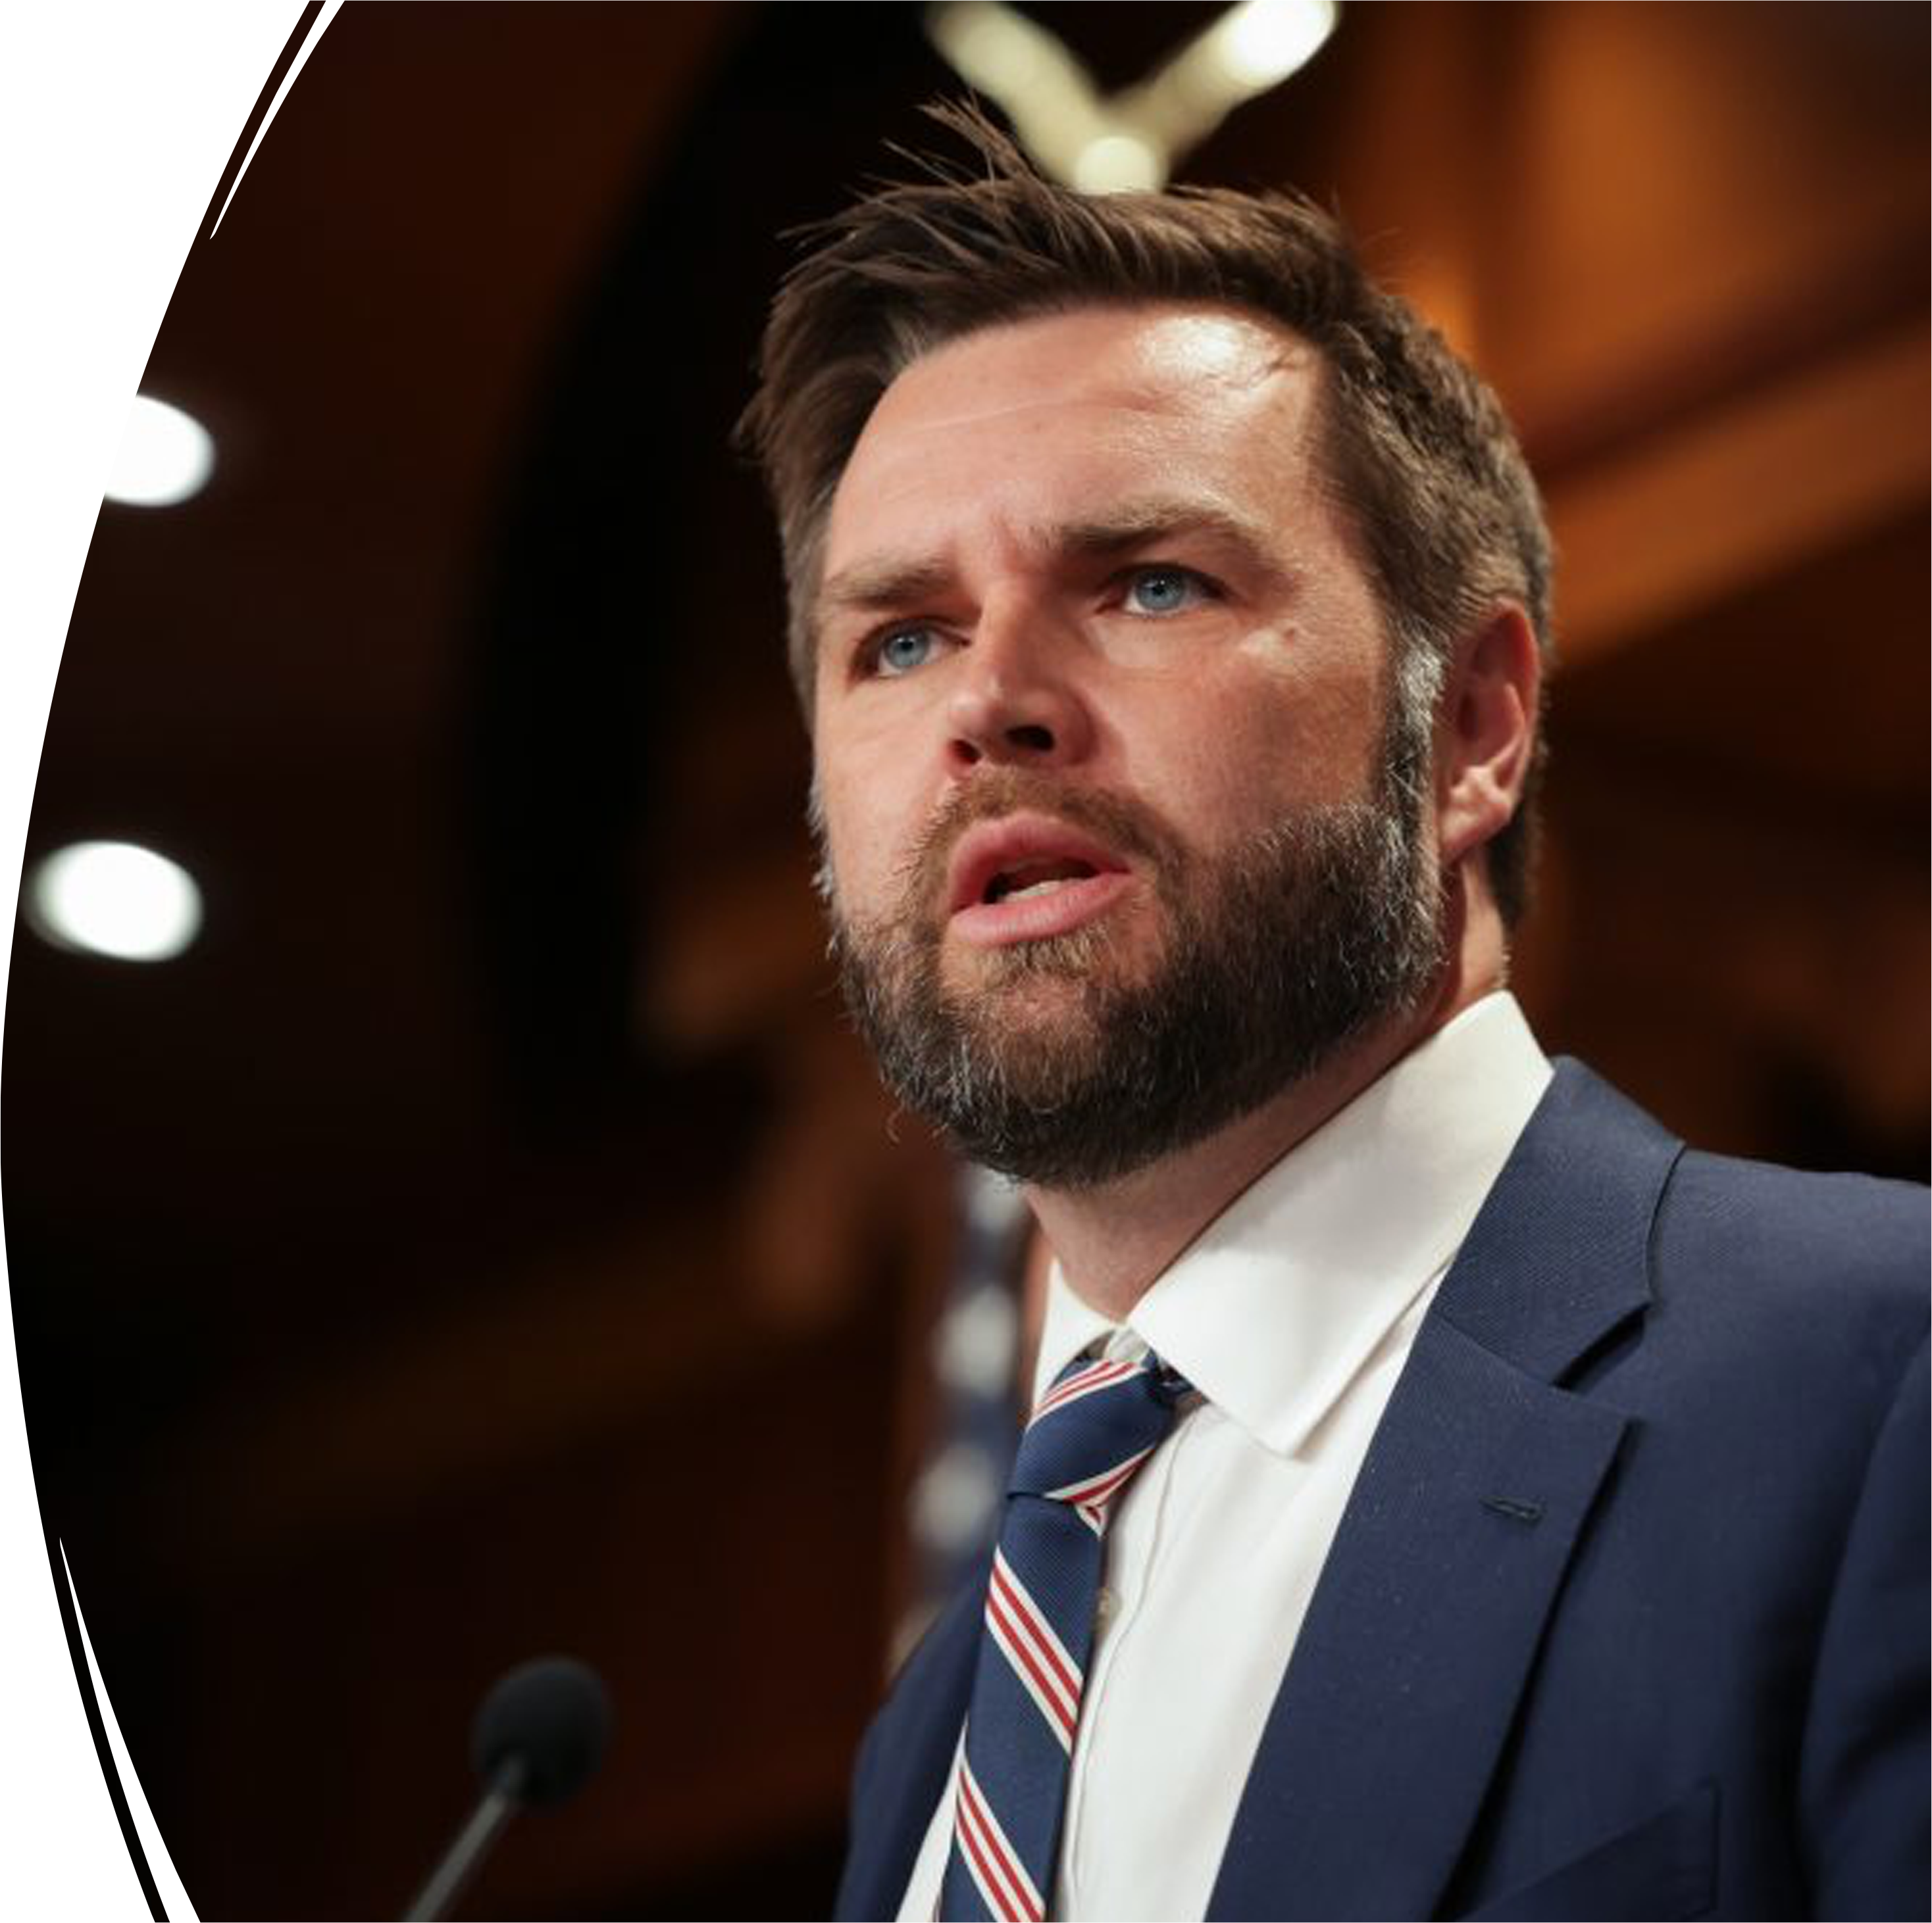
Sen. J.D.
Vance
J D ヴァンス
上院議員

Slide 73
J D ヴァンス上院議員
冷戦に負けた

Slide 74
経済 Fox News マリヤ・バリトロモ
トランプ イスラエル

Slide 75
経済 Fox News マリヤ・バリトロモ

Slide 76
Identity Politicsのウソ
ビル・マー指摘
Identity politics Bill Marr
I’m not African American. I’m an American.
“Living in old Paradigm” Dems

Slide 77
最も成功している投資銀行家 ジム・リッカーズ
Trump will win Jim Richards
Insurrection

Slide 78
ファウンテン倶楽部とIFA会員
情報収集
＊シルバー
教育
＊ゴールド
発信
＊プラチナ

Slide 79
ファウンテン倶楽部 ＆ IFA会員特典

Slide 80
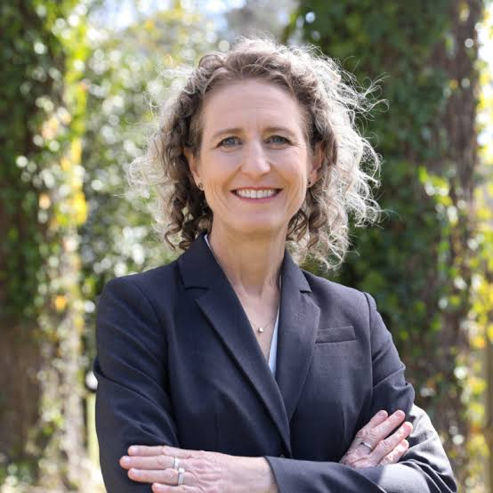
Jen Kiggans
４児の母で看護師
元海軍
ヘリコプター・パイロット ヴァージニア州下院議員
ジェン・ケーガン

Slide 81
ヴァージニア州下院議員 ジェン・ケーガン
BREAKING NEWS: Speaker Johnson Issues Blunt Message To Biden Over Border Before State Of The Union

Slide 82
I worry every day about the financial future （将来の収入と暮らし）for my children
I worry about the debt they're inheriting（借金のツケ）
I worry about if they're going to be able to buy a new car or buy a new house if they're going to be able to pay off their credit card bills （カード支払い）and still put food on their table
we know that Joe Biden has taken our energy Independence and he's put crippling regulation and mandates on our businesses （他国にエネルギーを依存させた政策）
we‘re in an economic crisis right now that has taken the American dream away（アメリカンドリームを奪った） from so many families including my own children

